Slide 1
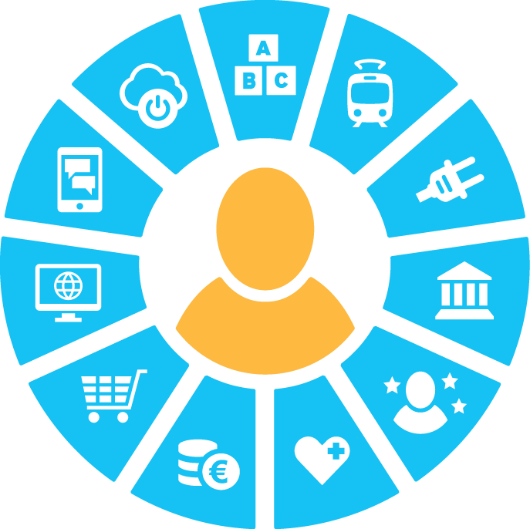
MyData Global
Sari Stenfors July 16, 2019
MyData Silicon Valley

Slide 2
PERSONAL DATA IS EVERYWHERE
Learning
Internet of Things
Mobility
Media and Comms
Energy
Apps
Public Services
Retail
Self Measurement
Insurance and Finance
Health
Notes:
object: MyData Wheel (logo)

Slide 3
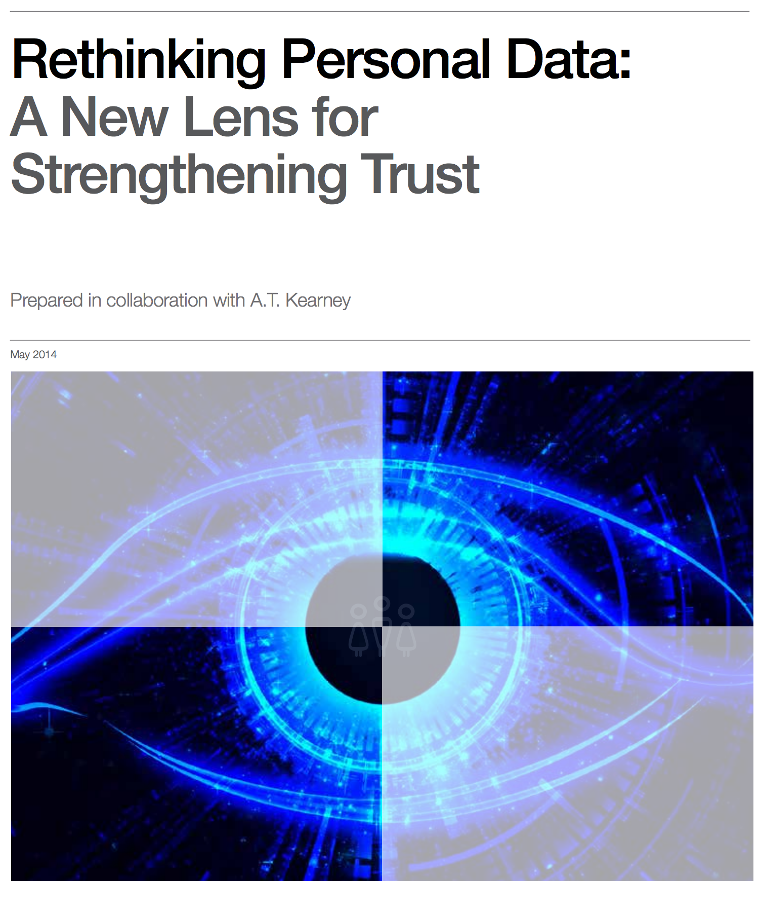
Personal data is a new economic “asset class”, a valuable resource for the 21st century that will touch all aspects of society.
World Economic Forum

Slide 4




Notes:
Hack it movie July 24 from netflix. Cambridge Analytica. Movie our Board member Paul-Olivier Dehaye in it.

Slide 5

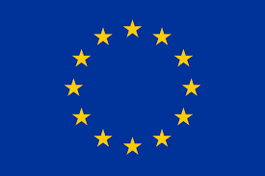

US
End of privacy?
Europe
Complex fight for privacy
China
State owned digital identities
NSA behavior and national security act as a baseline for how the state is treating individuals’ privacy.
No evident state-led initiative for trust networks or an interoperability model.
GAFAs dominate the global commercial online market and commercially significant digital identities.
Most core technologies in identity management and authorisation are developed in the US.
GDPR, PSD2 and other legal initiatives exist for protecting individual rights.
In different countries, cultural preferences and national initiatives vary.
Initiatives exist for building a unified single digital market.
Development of frameworks (such as Eidas) for trusted federated digital identities.
There are no globally significant European online service companies.
National Social Credit System (SCS) for identity trust attributes.
State controlled (or partly controlled) Baidu, Weibo, WeChat are significant services in domestic markets.
Rolling out digital identities for companies and services.
National control on identities.
Services such as sesame credit are defining individual’s trust level.

Slide 6
Current state
Opportunity
Solution
Trust is Broken
78% of consumers feel that it is hard to trust companies in how they manage personal information - The future of Digital Trust - Orange (2014)
Trillion$
The Value of Our Digital Identity Boston Consulting Group (2012)
Solving the trust challenge requires interoperability and new practices
Brands
Technology
Usability
Practices
Governance
Notes:
MyData keskittyy palauttamaan luottamuksen yrityksen ja yksilön välillä tiedon käsittelyssä.

Slide 7
What is MyData?

Slide 8

MyData
Alternative vision
Guiding principles
Global organization
Meetings & conferences

Slide 9
MyData Vision
The core idea of MyData is that individuals should be in control of their own data.
The MyData approach aims at strengthening digital human rights while opening new opportunities for businesses to develop innovative personal data based services built on mutual trust.
Notes:
object: MyData Vision

Slide 10
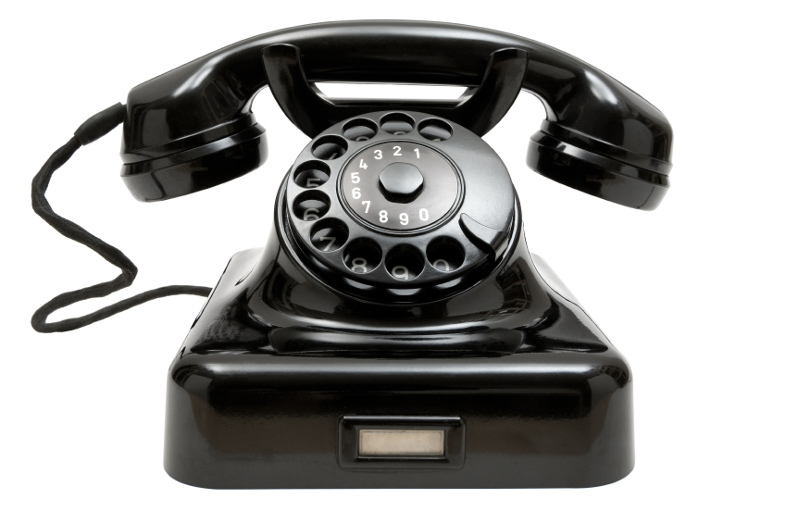
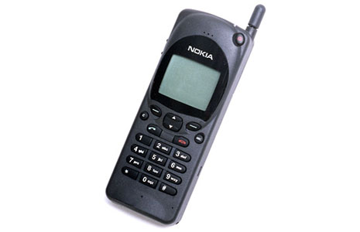
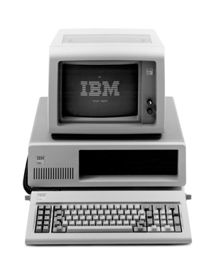
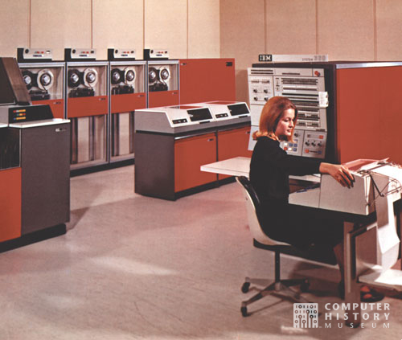


MyData Change
Landline telephone
(calling a fixed location)
Mainframe
Traditional warehousing
of personal data
Mobile telephony
(calling to a person)
Personal computer
Human-centric organization of personal data

Slide 11

Data into the Interaction
Traditionally data is in organization’s back office systems
Organization or Service
(i.e. customer service)
Data
Data is part of the individual-organization relationship.
In MyData approach the individual can access, control, enrich and modify the data.
Organization or Service
(i.e. customer service)
Data
Notes:
object: Data is part of the individual-organization relationship

Slide 12
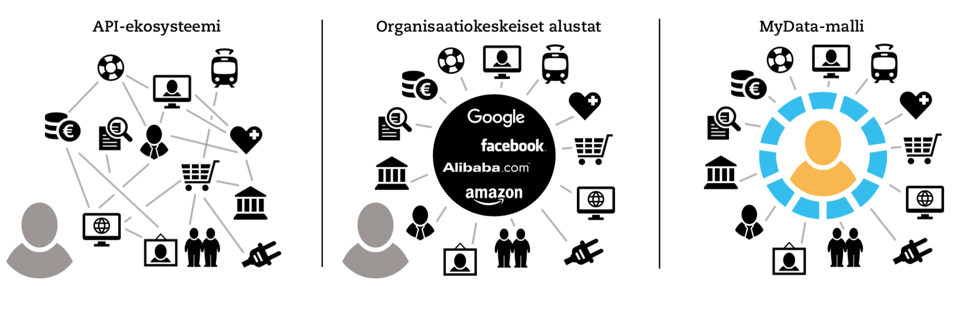
How is MyData different?
Individual as the connection and control point
API Ecosystem
Platform Model
MyData Model
Connection point: data from one person can be connected
(compare to geolocation as correlation point for location data)
Control point: Individual decides who uses her data and how by giving consent
(permissions can be changed later)
Notes:
object: ecosystem, Aggregator and Mydata

Slide 13
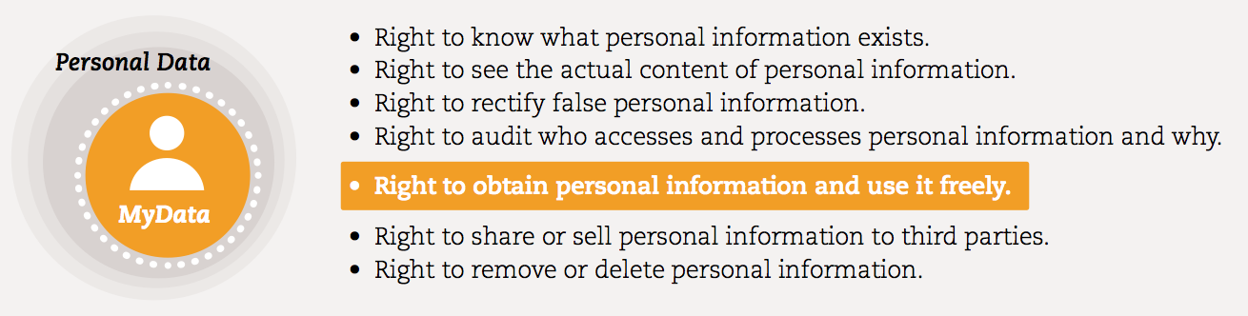
MyData is human centered approach to personal data management and processing.
Rights and practical means for people to access and use their personal data and to authorize others to use the data.
Notes:
object: Rights and data - MyData is a Subset of Personal Data

Slide 14
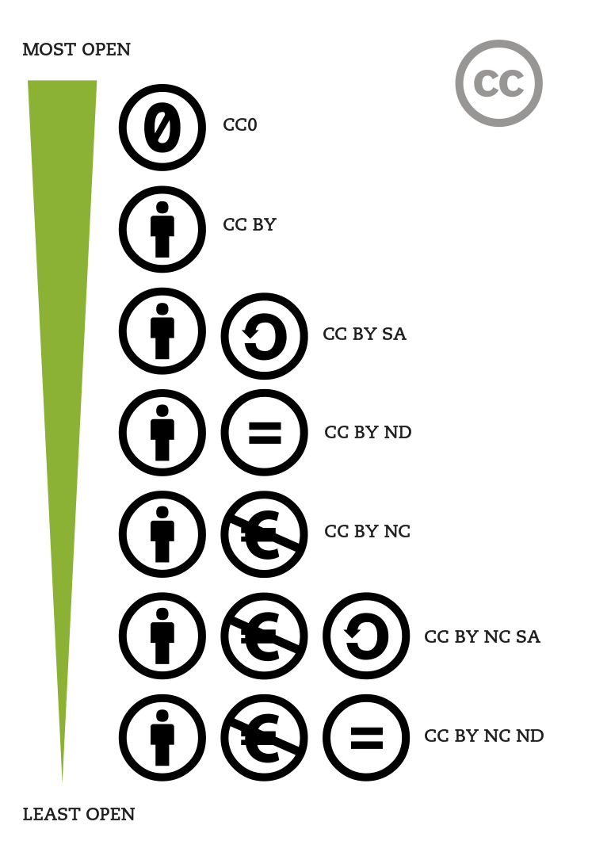
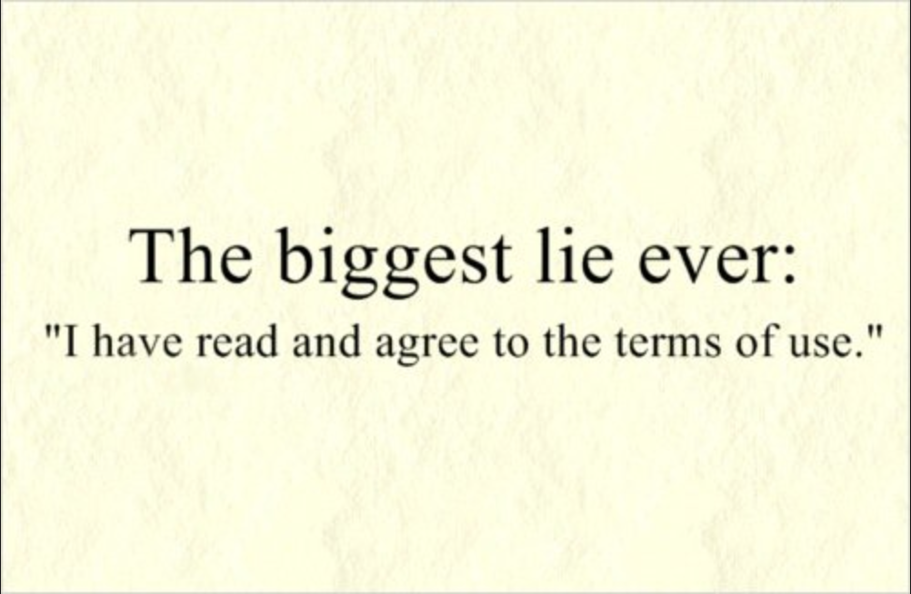
Standard Agreements
Current state
Consents are not comprehensive
Not dynamic
They do not allow access for individuals to their own data
MyData goal
Similar framework for personal data as CC is for copyright
Also dynamic properties
Addressing data

Slide 15
How is MyData Done?

Slide 16
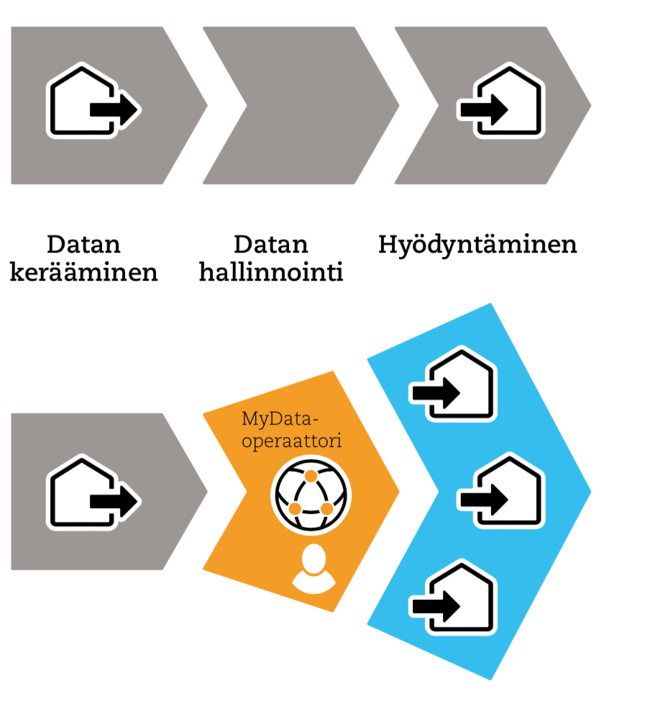
Currently:
Organizations manage the whole value chain
Integrating data from multiple sources is hard
Collect
Manage
Use
MyData Future:
Specialized services for different parts of the value chain
Need mechanisms for permissions (consent etc.)

Slide 17
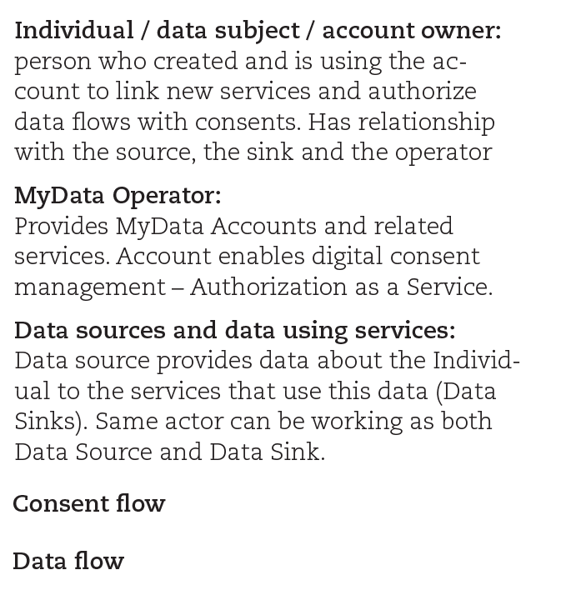
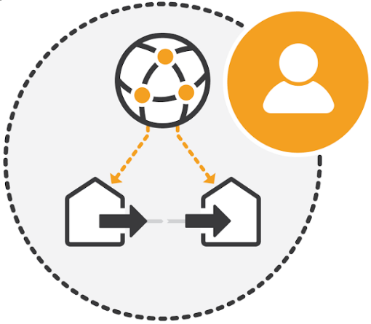
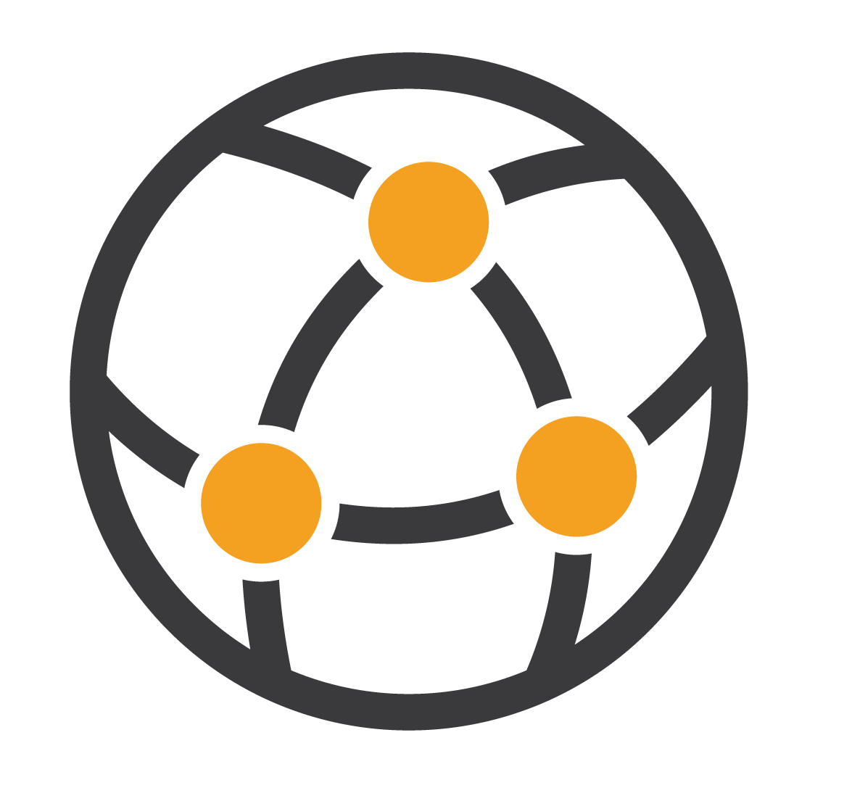
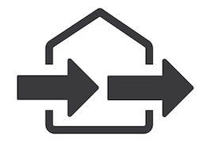
MyData Operator Model
Person (Principal)
Operator (Custodian)
Data Sources and Data Using Services (Providers and Relying Parties)
Permission Flow
Data Flow

Slide 18
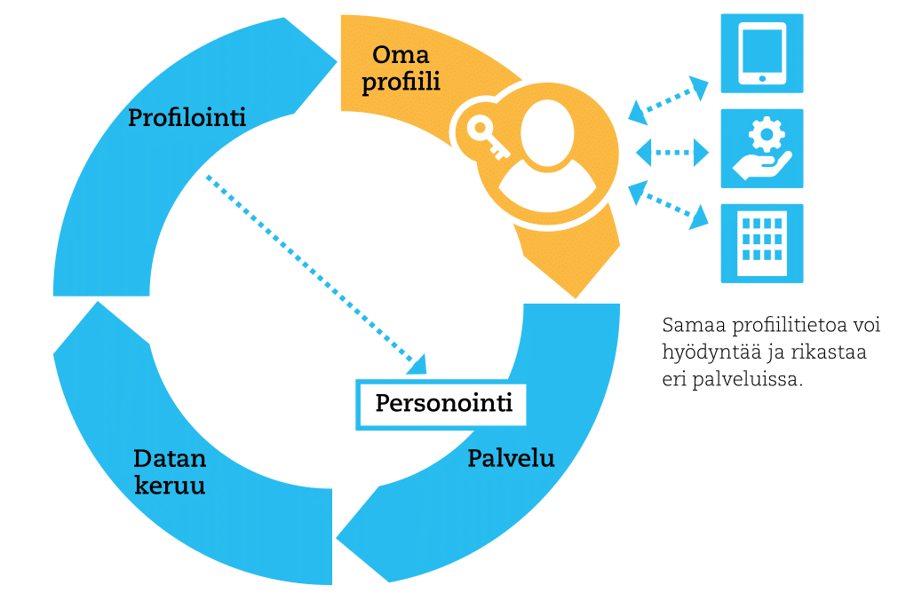
Own
Profile
Profiling
Same profile information can be used and enriched in many services.
Personalization
Data
Collection
Service
Notes:
object: Portable Profile
http://okffi.github.io/mydata/fi_2018.html#itse-kootut-profiilit-siirrett%C3%A4v%C3%A4-mediaprofiili
Kuva 3.3: Perinteisesti käyttäjädatan keruuseen ja analysointiin pohjautuva profilointi ja palvelun personointi tapahtuvat yksittäisen palvelun sisällä (siniset nuolet), eikä kertynyttä profiilitietoa voi tällöin hyödyntää muualla, eikä toisaalta profiilin muodostamiseen ole käytettävissä muissa palveluissa syntynyttä käyttäjädataa. MyData-mallin mukainen ihmisen itse hallitsema profiilitieto (oranssi) mahdollistaisi tiedon koostamisen useista lähteistä ja saman profiilin hyödyntämisen eri palveluissa.

Slide 19
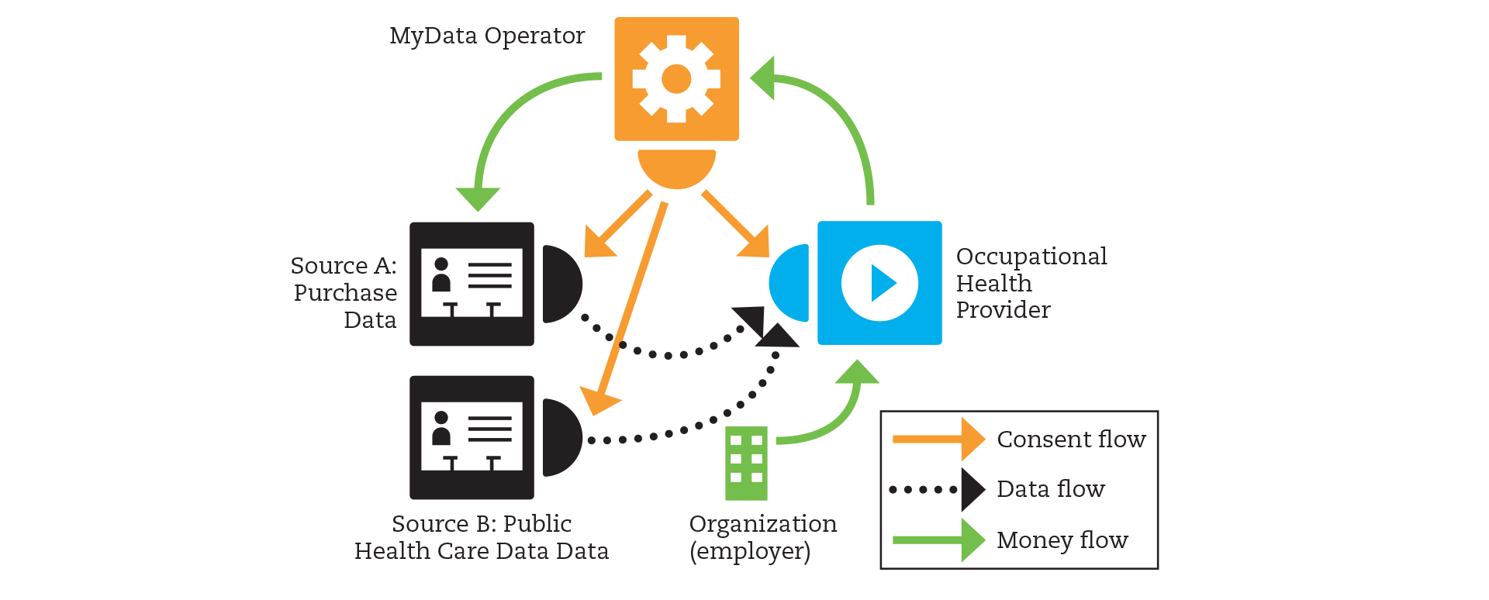
CASE: Health Care

Slide 20
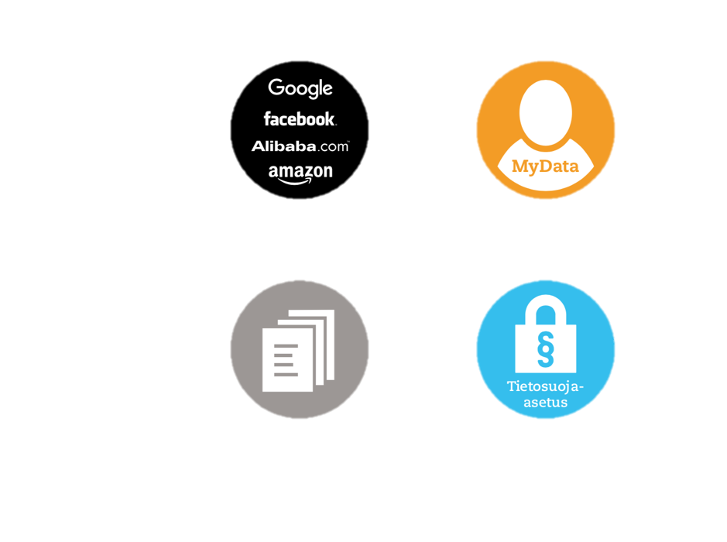
Lots of data usage
Organisations decide
People decide
Less usage of personal data
Old paper times
Comply with the GDPR
Weak
Data Protection
Strong
Data Protection

Slide 21
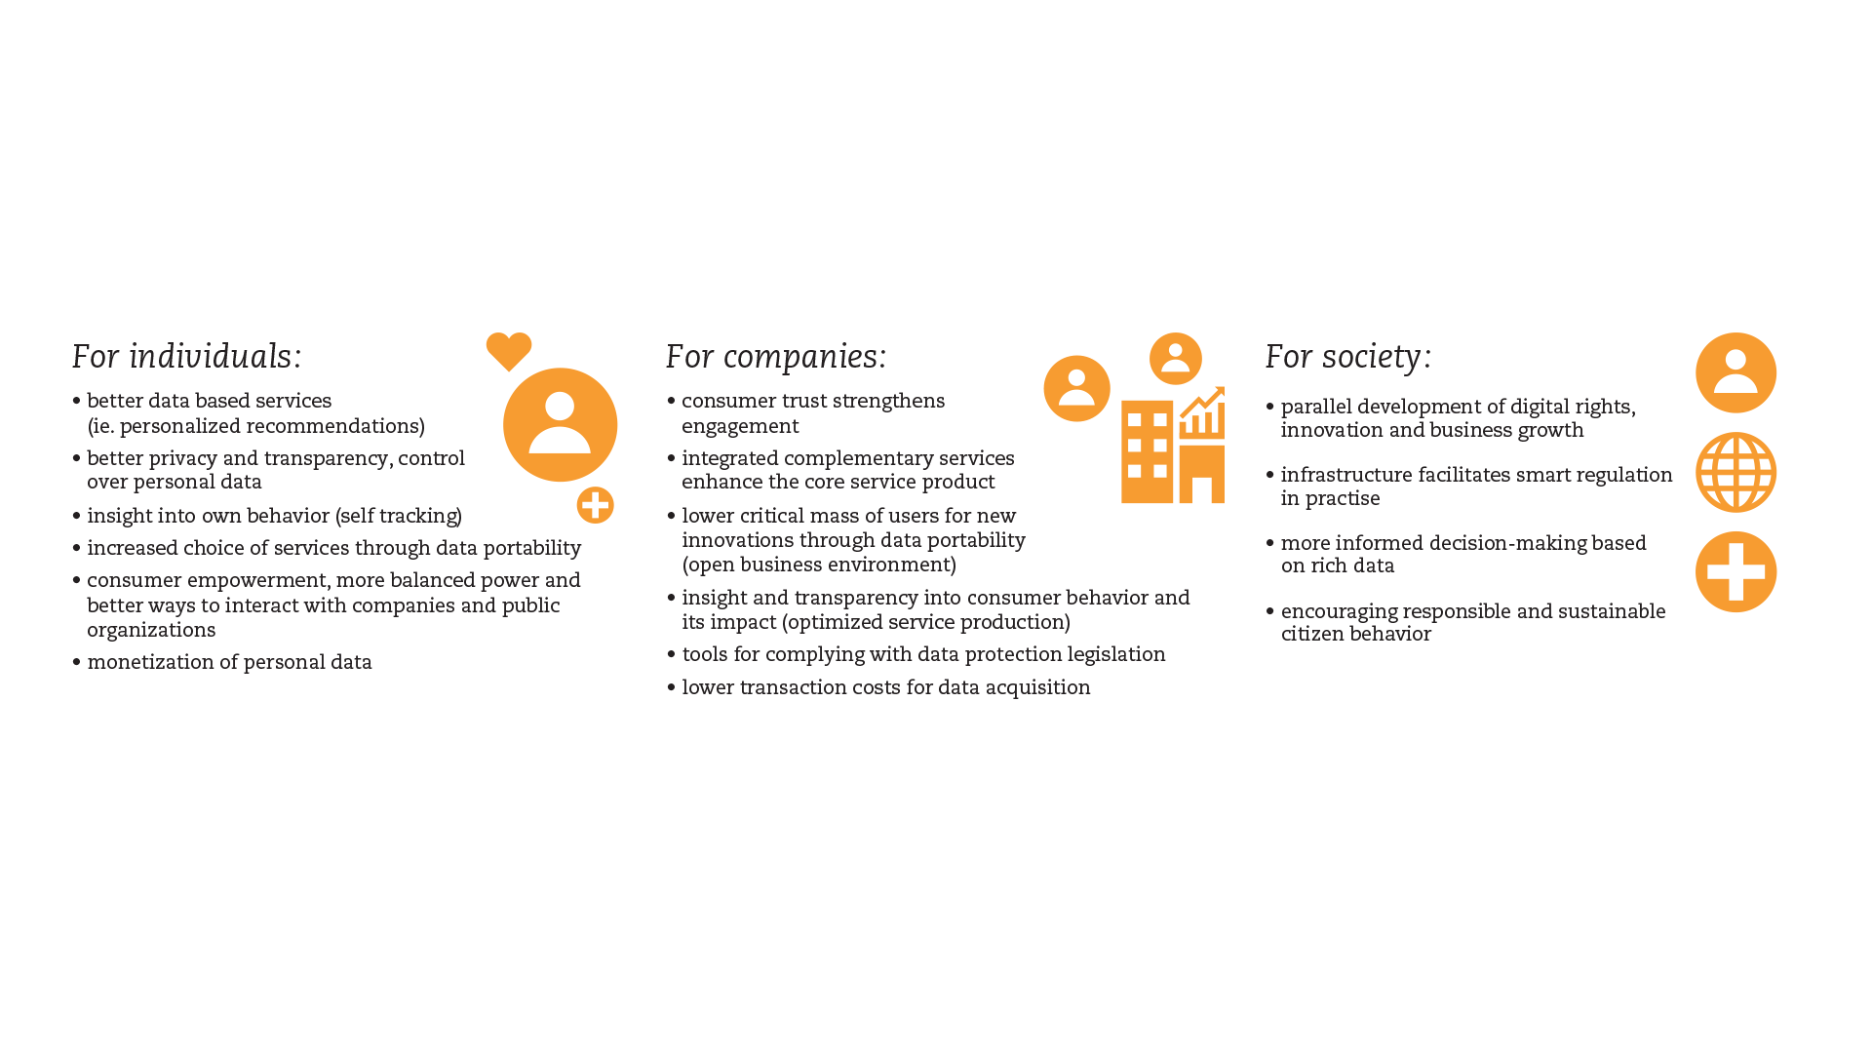
Benefits

Slide 22
MyData Declaration

Slide 23
1
MYDATA SHIFTS:
WHAT NEEDS TO CHANGE
2
MYDATA ROLES:
WHO DOES WHAT
3
MYDATA PRINCIPLES:
WHAT WE WANT TO ACHIEVE
4
ACTION:
WHAT SHOULD HAPPEN NOW
https://mydata.org/declaration

Slide 24
1
MYDATA SHIFTS:
WHAT NEEDS TO CHANGE
1.1. FROM FORMAL TO ACTIONABLE RIGHTS
1.2. FROM DATA PROTECTION TO DATA EMPOWERMENT
1.3. FROM CLOSED TO OPEN ECOSYSTEMS
https://mydata.org/declaration
Notes:
object: MyData Shifts

Slide 25
3
MYDATA PRINCIPLES:
WHAT WE WANT TO ACHIEVE
3.1 HUMAN-CENTRIC CONTROL OF PERSONAL DATA
3.2 INDIVIDUAL AS THE POINT OF INTEGRATION
3.3 INDIVIDUAL EMPOWERMENT
3.4 PORTABILITY: ACCESS AND RE-USE
3.5 TRANSPARENCY AND ACCOUNTABILITY
3.6 INTEROPERABILITY
https://mydata.org/declaration
Notes:
3.1 HUMAN-CENTRIC CONTROL OF PERSONAL DATA
Individuals should be empowered actors in the management of their personal lives both online and offline. They should be provided with the practical means to understand and effectively control who has access to data about them and how it is used and shared.
We want privacy, data security and data minimisation to become standard practice in the design of applications. We want organisations to enable individuals to understand privacy policies and how to activate them. We want individuals to be empowered to give, deny or revoke their consent to share data based on a clear understanding of why, how and for how long their data will be used. Ultimately, we want the terms and conditions for using personal data to become negotiable in a fair way between individuals and organisations.
3.2 INDIVIDUAL AS THE POINT OF INTEGRATION
The value of personal data grows exponentially with their diversity; however, so does the threat to privacy. This contradiction can be solved if individuals become the “hubs” where, or through which cross-referencing of personal data happens.
By making it possible for individuals to have a 360-degree view of their data and act as their “point of integration”, we want to enable a new generation of tools and services that provide deep personalisation and create new data-based knowledge, without compromising privacy nor adding to the amount of personal data in circulation.
3.3 INDIVIDUAL EMPOWERMENT
In a data-driven society, as in any society, individuals should not just be seen as customers or users of pre-defined services and applications. They should be considered free and autonomous agents, capable of setting and pursuing their own goals. They should have agency and initiative.
We want individuals to be able to securely manage their personal data in their own preferred way. We intend to help individuals have the tools, skills and assistance to transform their personal data into useful information, knowledge and autonomous decision-making. We believe that these are the preconditions for fair and beneficial data-based relationships.
3.4 PORTABILITY: ACCESS AND RE-USE
The portability of personal data, that allows individuals to obtain and reuse their personal data for their own purposes and across different services, is the key to make the shift from data in closed silos to data which become reusable resources. Data portability should not be merely a legal right, but combined with practical means.
We want to empower individuals to effectively port their personal data, both by downloading it to their personal devices, and by transmitting it to other services. We intend to help Data Sources make these data available securely and easily, in a structured, commonly-used and machine-readable format. This applies to all personal data regardless of the legal basis (contract, consent, legitimate interest, etc.) of data collection, with possible exceptions for enriched data.
3.5 TRANSPARENCY AND ACCOUNTABILITY
Organisations that use a person’s data should say what they do with them and why, and should do what they say. They should take responsibility for intended, as well as unintended, consequences of holding and using personal data, including, but not limited to, security incidents, and allow individuals to call them out on this responsibility.
We want to make sure that privacy terms and policies reflect reality, in ways that allow people to make informed choices beforehand and can be verified during and after operations. We want to allow individuals to understand how and why decisions based on their data are made. We want to create easy to use and safe channels for individuals to see and control what happens to their data, to alert them of possible issues, and to challenge algorithm-based decisions.
3.6 INTEROPERABILITY
The purpose of interoperability is to decrease friction in the data flow from data sources to data using services, while eliminating the possibilities of data lock-in. It should be achieved by continuously driving towards common business practices and technical standards.
In order to maximise the positive effects of open ecosystems, we will continuously work towards interoperability of data, open APIs, protocols, applications and infrastructure, so that all personal data are portable and reusable, without losing user control. We will build upon commonly accepted standards, ontologies, libraries and schemas, or help develop new ones if necessary.

Slide 26
MyData Action

Slide 27



Open Knowledge Workshop
Notes:
MYDATA GLOBAL 2018, CONFERENCE 2019

Slide 28
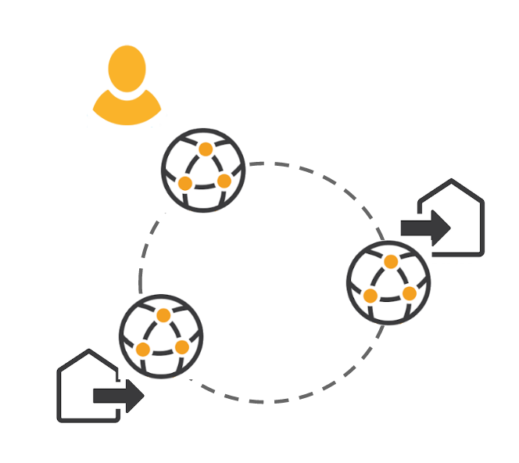
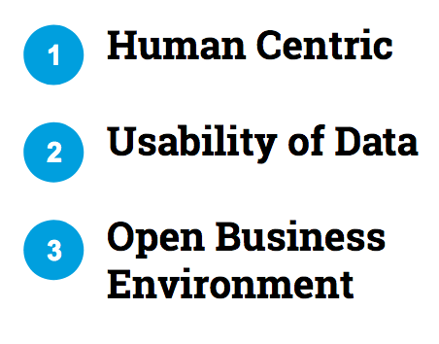
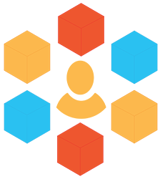
BUILDING AN OPEN ECOSYSTEM
1. VISION
2. PRINCIPLES
3. OPERATOR
MODEL
4. TECHNICAL
BUILDING
BLOCKS
5. BUSINESS
MODELLING
6. ESTABLISHING
OPERATORS
(TRUST NETWORK)
Value for all?
2012
2013
2014
2015
2016
2017
Individual
thinkers
Working
Group
White Paper
in Finnish
Gov.
agenda
White Paper
in English
EU Commission
“PIMS round table”
MyData
Conf. 2016
TrustNet
Proposal
First events
MyData
Alliance (EE)
International
contacts
Company
involvement
Academic
research
MyData
Alliance (FI)
Scaling up
the activity
Finnish gov.
involvement
Gov. spearhead
programmes
MyData -pilot in
national data-infra.
Open Ecosystem: Low entry barrier, interoperability, fair and transparent governance (who sets the rules), balanced value sharing...
Notes:
Object: Building an Open Ecosystem (Timeline)
Low entry barrier, interoperability, fair and transparent governance (who sets the rules), balanced value sharing
Who are involved: Individuals (needs and preferences), companies (data providers and users, use-cases), research (facilitation role, hard problems, first trials, educating and building capacity), potential MyData operators (new role: new entities?, PIMS, Banks, Telcos, Gov, Individuals “self-operating”) government (regulation, funding, use-cases), media (awareness), NGOs (awareness, community building, citizen activism, lobbying), startups (specific solutions for individuals, data providers, data users and the operators)…

Slide 29
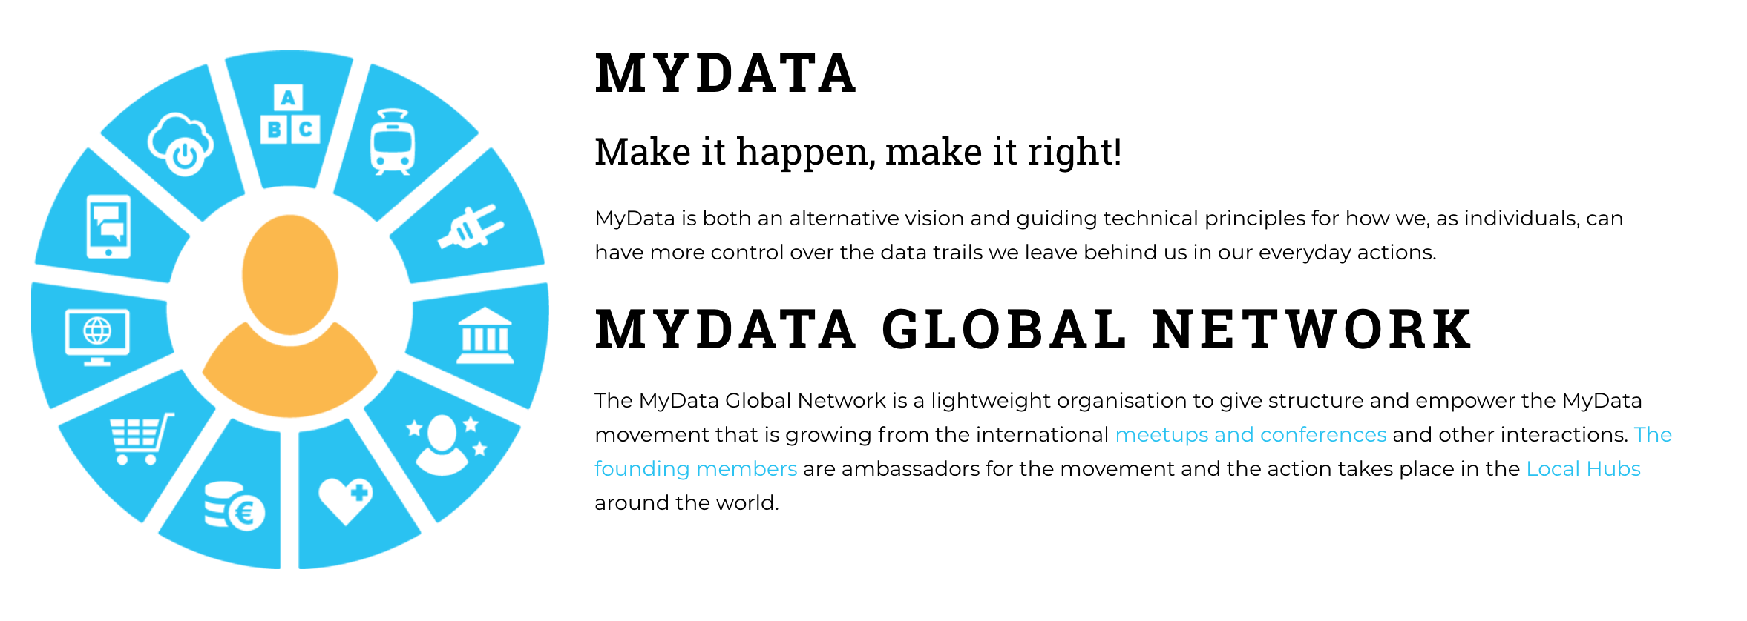
MyData.org (Global nonprofit)

Slide 30
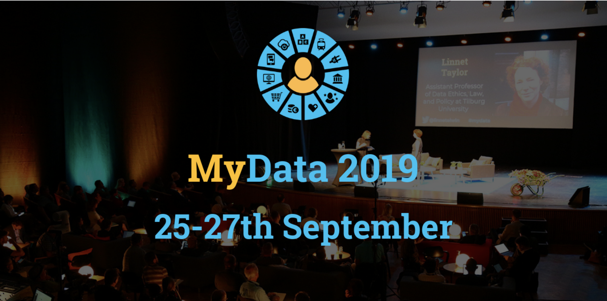

Slide 31

MyData in the Government Agenda
“We will provide an opportunity for individuals to manage their personal data in public information systems in accordance with the MyData principle and to give permission for their use in other services.”
“Information will be gathered on different ways to better ensure people’s rights to administer their personal data according to the MyData principles. The objective will be promoted by both national and international regulation.”
Finland’s Government Programme 6.6.2019, p. 120 & 195
Notes:
“Kansalaisten oikeutta omaan digitaaliseen tietoon ja yksityisyyden suojaan vahvistetaan. Yksilöille luodaan mahdollisuus hallita omia julkisissa tietojärjestelmissä olevia henkilötietojaan omadata-periaatteen mukaisesti ja antaa lupa niiden käyttöön muissa palveluissa.”
“Kootaan tietoa eri tavoista turvata paremmin kansalaisten oikeuksia hallinnoida omia tietojaan omadata-periaatteen mukaisesti. Edistetään tavoitetta niin kansallisessa kuin kansainvälisessä sääntelyssä.”
Antti Rinteen hallituksen ohjelma 3.6.2019 - s.106 & 112

Slide 32
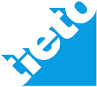










Pilots Contributing to the MyData Core
CRM as a Service
Mobility as a Service
MyData
CORE
SC
PDS,
Profile
Research Data Banking
Retail
UMA
Consent Management / UMA
Service Registry / Connection
Personal Data Storage
Aggregation & Anonymization
Local Application & Analytics
Profile creation & portability
Self tracking
A&A
UMA
SC
PDS
A&A
QS
UMA
Media
Telecom
Analytics
Profile
Directive on Payment Services PSD2
Health
Finance
QS
Notes:
object: Pilots Contributing to the MyData Core

Slide 33


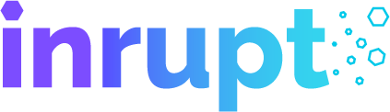

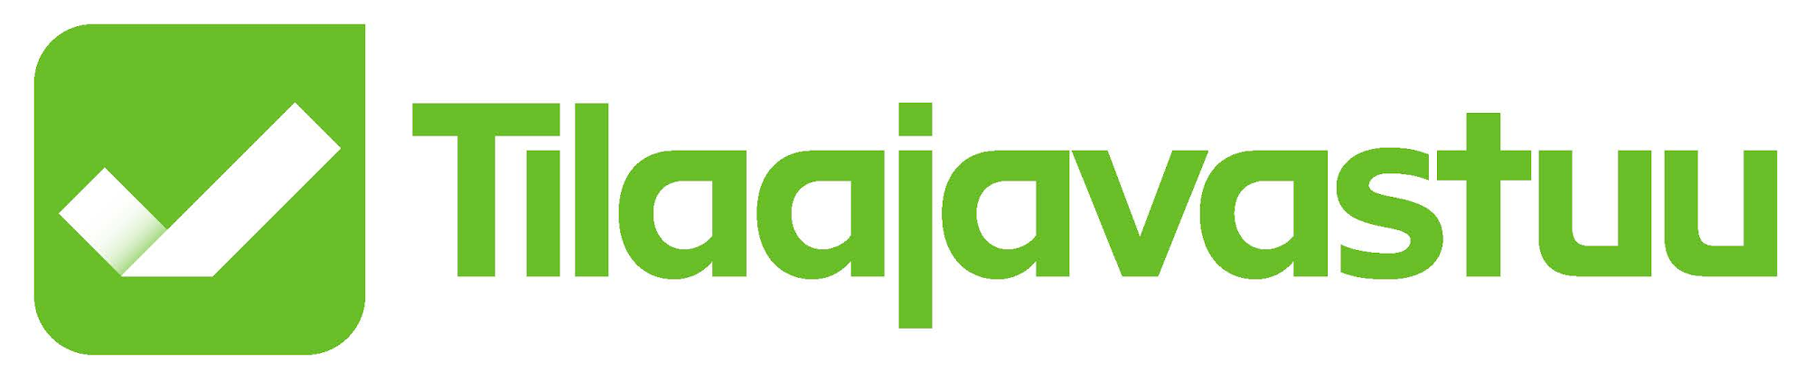






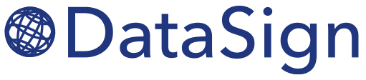

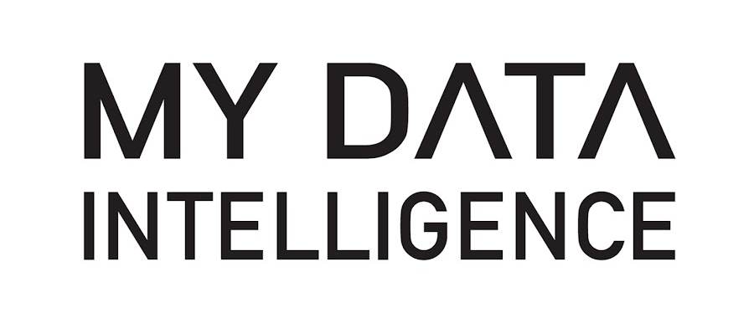




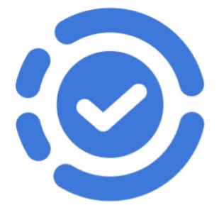


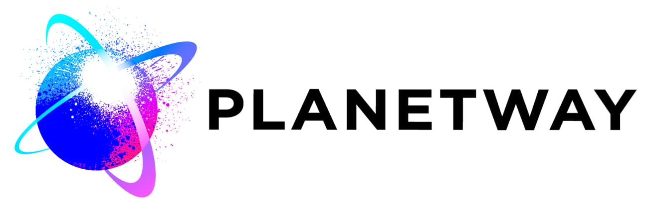


Hundreds but not yet thousands
“MyData Operator” like initiatives Globally

Slide 34
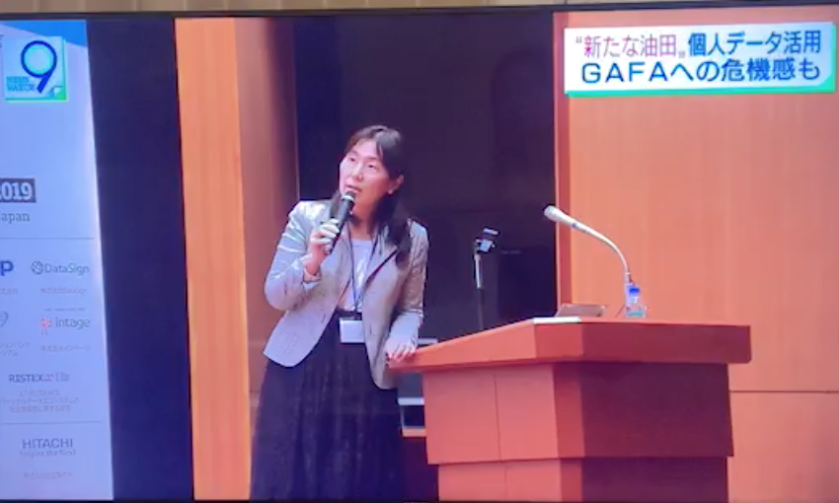

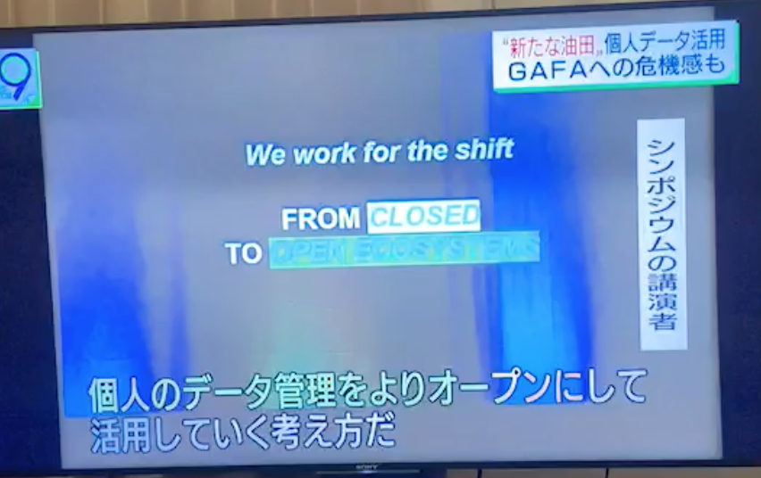
MyData Japan in television 5/15/2019

Slide 35

MyData Operators?
US
Information Fiduciaries
Economic relationships with asymmetrical power.
Traditional “fiduciaries” → doctors, lawyers, and accountants.
Fiduciaries owe their customers a duty of loyalty and duty of care → they cannot use their customers’ information against customers’ interests.
Duties are enforced by government licensing boards, and by customer lawsuits.
Japan
Information Banks
“Anti GAFA” struggle to find antidote for the global centralization of data economy.
Aging population → do people have interest and capability to execute individual rights?
Organisations should help people.
Government set certification scheme for “information banks” that can act on behalf of the individuals regarding their data.

Slide 36
Are you dreaming of Interoperable Open Markets for Personal Data?
Notes:
Low transaction costs, Integrated payment mechanism
Legal compliance, auditability, good governance
Trust, transparency
Free choice for people, fair and balanced
Understandable
Healthy competition, Network effects benefitting all
Interoperability
Ease of use, design simplicity

Slide 37
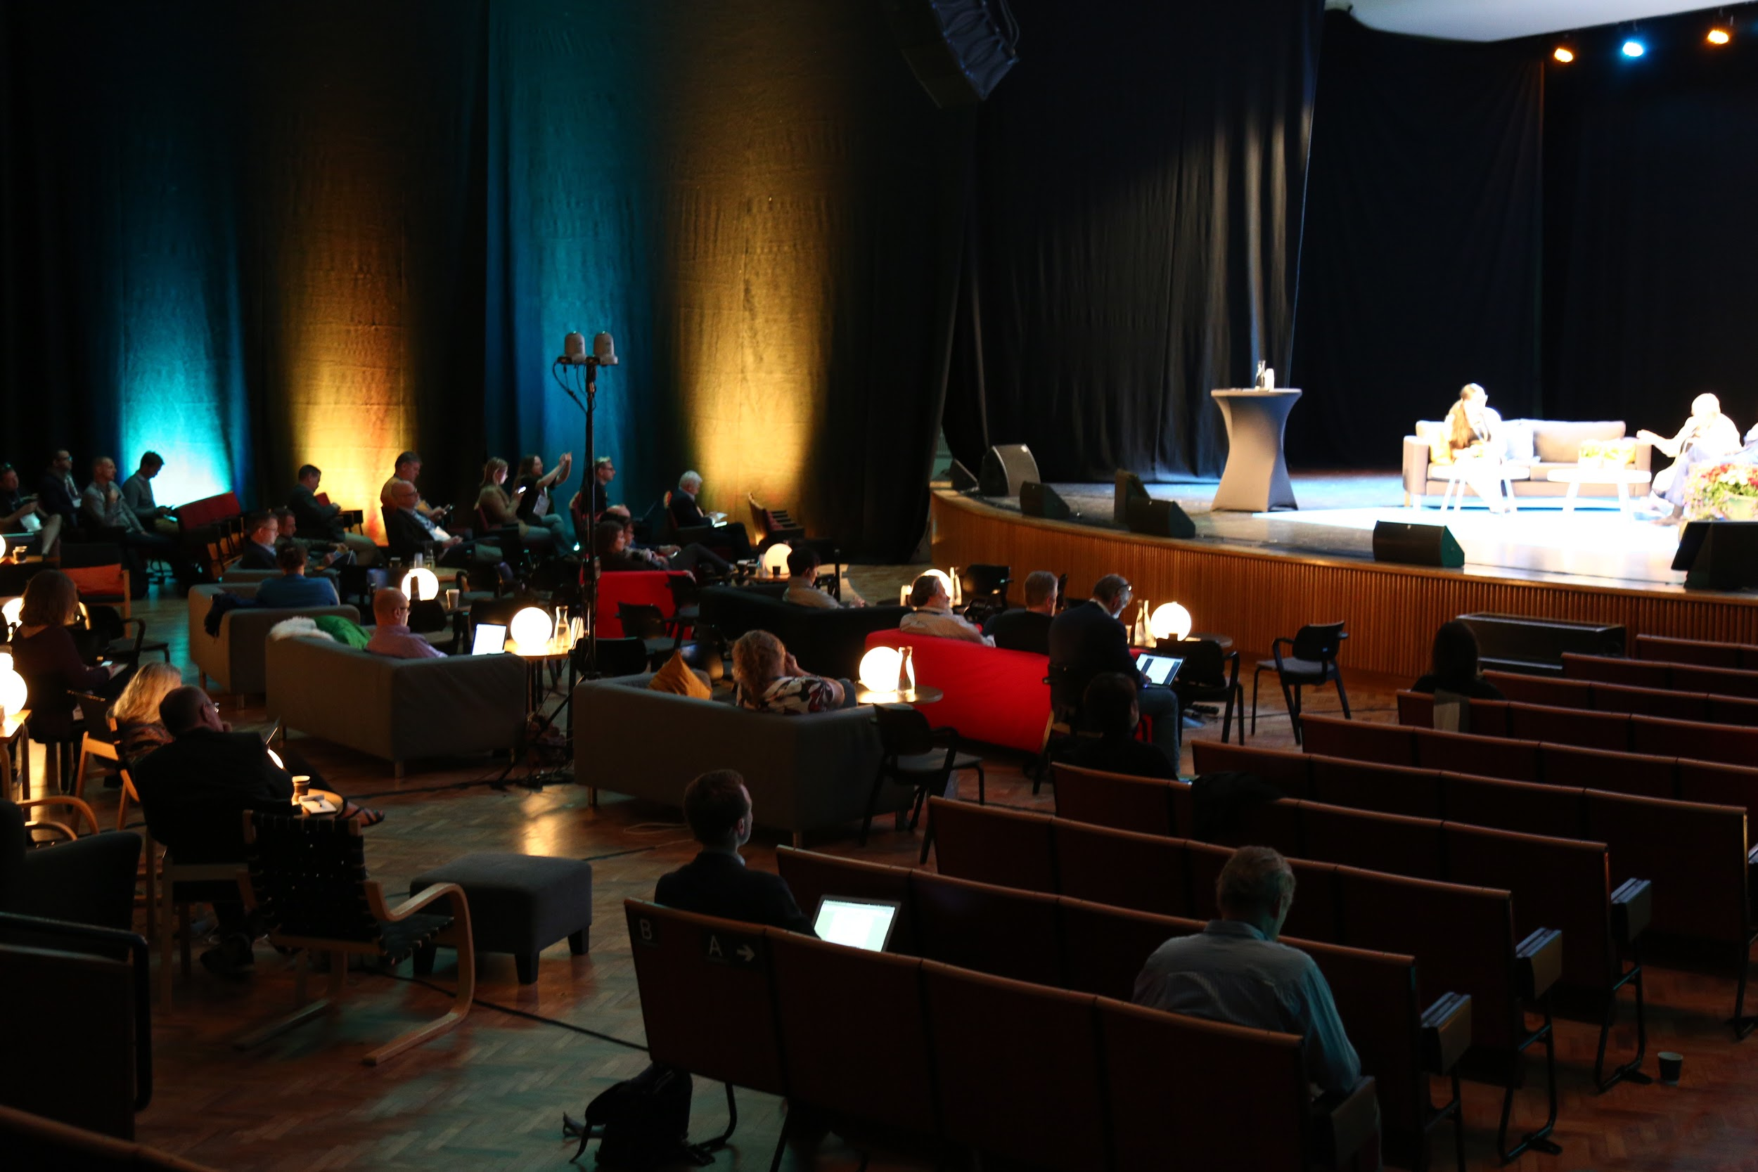
DECLARATION OF
MYDATA PRINCIPLES
(v1.0)
https://mydata.org/declaration

Slide 38
Thank you! sari@aulead.com

